Slide 1

Utsav by the Bay
Teamwork Arts, India producers of the iconic
Jaipur Literature Festival proudly presents
JLF Spain
India and Portugal
Words are Bridges
The festival will showcase a vibrant celeerations of Indian and Portugese Culture embodying vibrant and multi-cultural identity, straddling the classical, the folk and indigenous and the contemporary from both the countries. Utsav, the Celebrations, aims to capture the spirit of collaboration through a shared cultural experience across artistic art forms and expressions. The festival will celebrate Indo - Portuguese relations through dance, music, literature, food and processions.

Slide 2
JAIPUR LITERATURE FESTIVAL
‘The Greatest Literary Show on Earth’
An open and democratic platform for debate and discussion that promotes inclusiveness.
A constant flow of ideas, while providing a space to dare, dream, and imagine.
Celebrating acclaimed international and Indian voices, including Nobel laureates and winners of Man Booker, Pulitzer Prize, Sahitya Akademi Prize, and JCB Prize for Literature.
Bridging cultural, geographical, and historical divides by bringing the world to India and India to the world.
The Festival has always represented a wide array of renowned authors from diverse genres and backgrounds, creating an inclusive space for discourse and conversations.

Slide 3
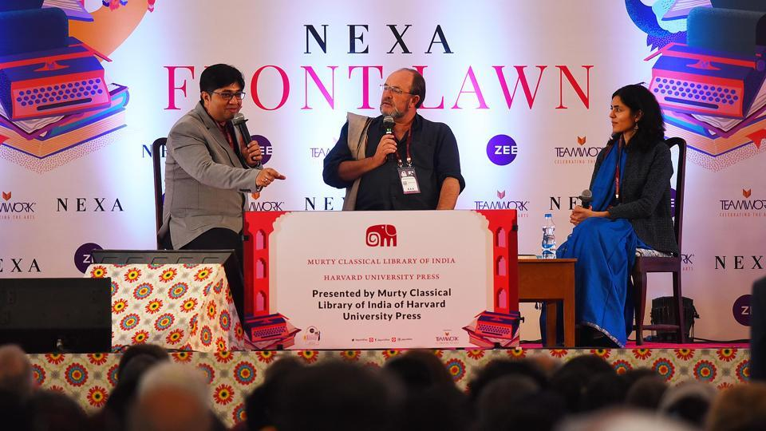
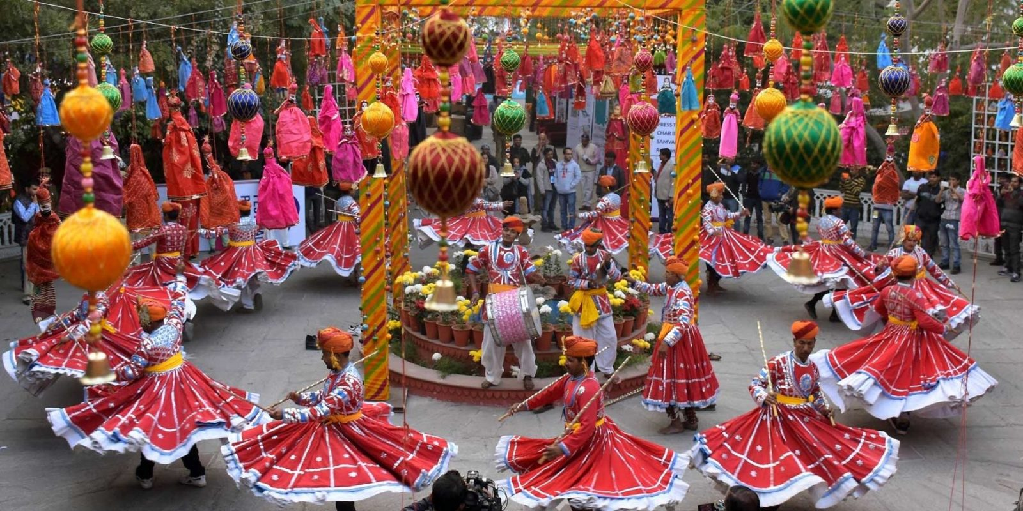
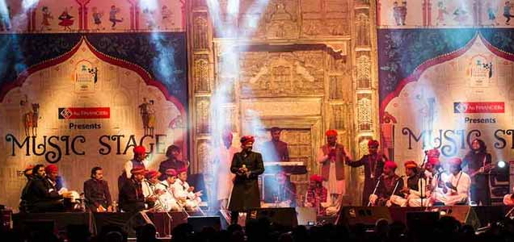
A BLEND OF LITERATURE, CULTURE AND HERITAGE
KEYNOTE ADDRESS
PANEL DISCUSSIONS
MUSIC PERFORMANCES
BOOKSHOP & BOOK SIGNING
RECEPTIONS

Slide 4
JLF in Maldives
JLF in UK
JLF in Ireland
JLF in USA
JLF in Canada
JLF in Australia
JLF in Qatar

Slide 5
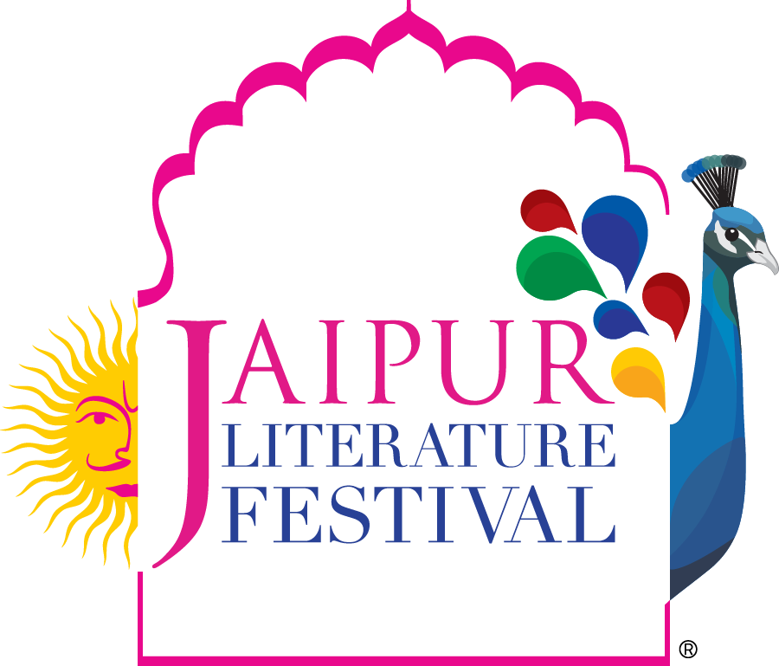










Slide 6
next stop
Words are Bridges
JLF Spain

Slide 7
Why JLF in Spain
JLF in Spain aims to capture the spirit of collaboration through a shared cultural experience across artistic art forms and expressions. The Festival will create a bridge between both the nations and their unique identities through a blend of literature, culture, and heritage events. JLF as a platform to share ideas and knowledge, would like to connect with the 500 million Spanish & Latin American population. Along with the 50000+ members of the Indian diaspora in Spain.

Slide 8
LITERATURE
JLF Spain brings together a diverse mix of writers, poets, thinkers on one platform to champion the freedom to expression and engage in thought-provoking and meaningful dialogue like
Living Cultural Heritage: Historic Cities and natural ecosystems.
Bridging Cultures through Stories: tales, travels, translations.
Shared connections and imagination: India and the Spanish- speaking world

Slide 9
TENTATIVE TOPICS
ENVIRONMENT & CLIMATE CHANGE
EUROPEAN POLITICS, STRATEGIC POLITICS & GEO POLITICS
GASTRONOMY & WINERY
HERITAGE & CULTURE
MYSTIC POETRY
ROMA & THE INDIAN CONNECT
TALK ON FILMS
TRANSLATIONS

Slide 10
Utsav by the Bay
TENTATIVE SPEAKRES
India and Portugal
Words are Bridges
JLF Spain
The festival will showcase a vibrant celeerations of Indian and Portugese Culture embodying vibrant and multi-cultural identity, straddling the classical, the folk and indigenous and the contemporary from both the countries. Utsav, the Celebrations, aims to capture the spirit of collaboration through a shared cultural experience across artistic art forms and expressions. The festival will celebrate Indo - Portuguese relations through dance, music, literature, food and processions.

Slide 11
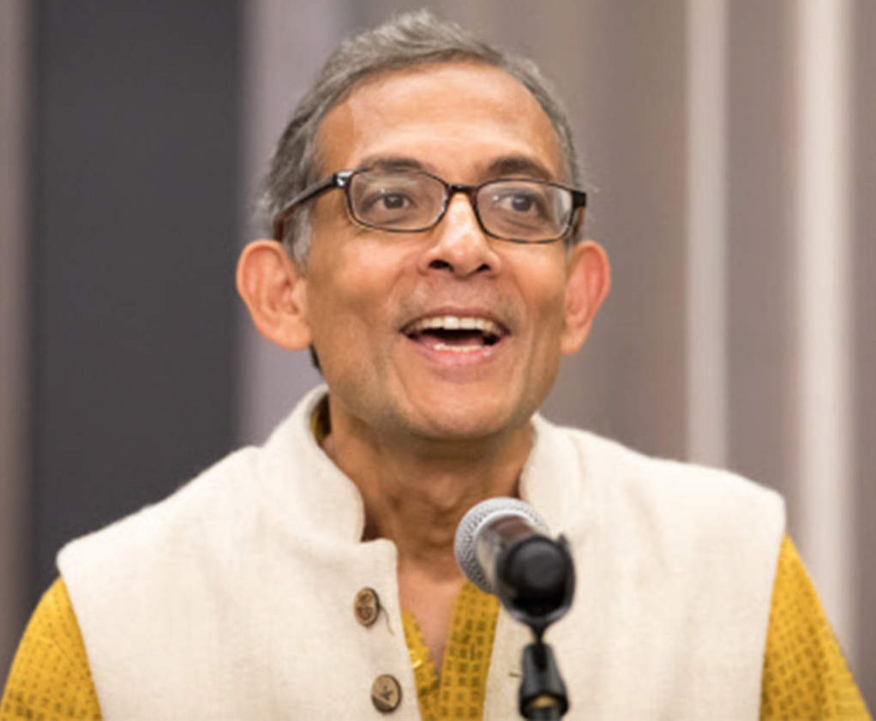
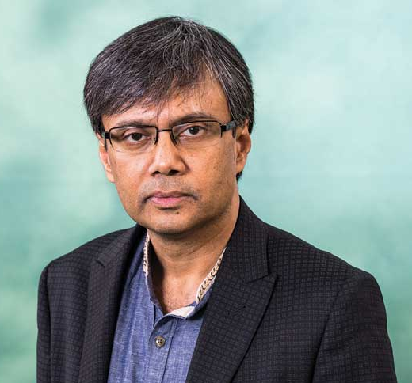
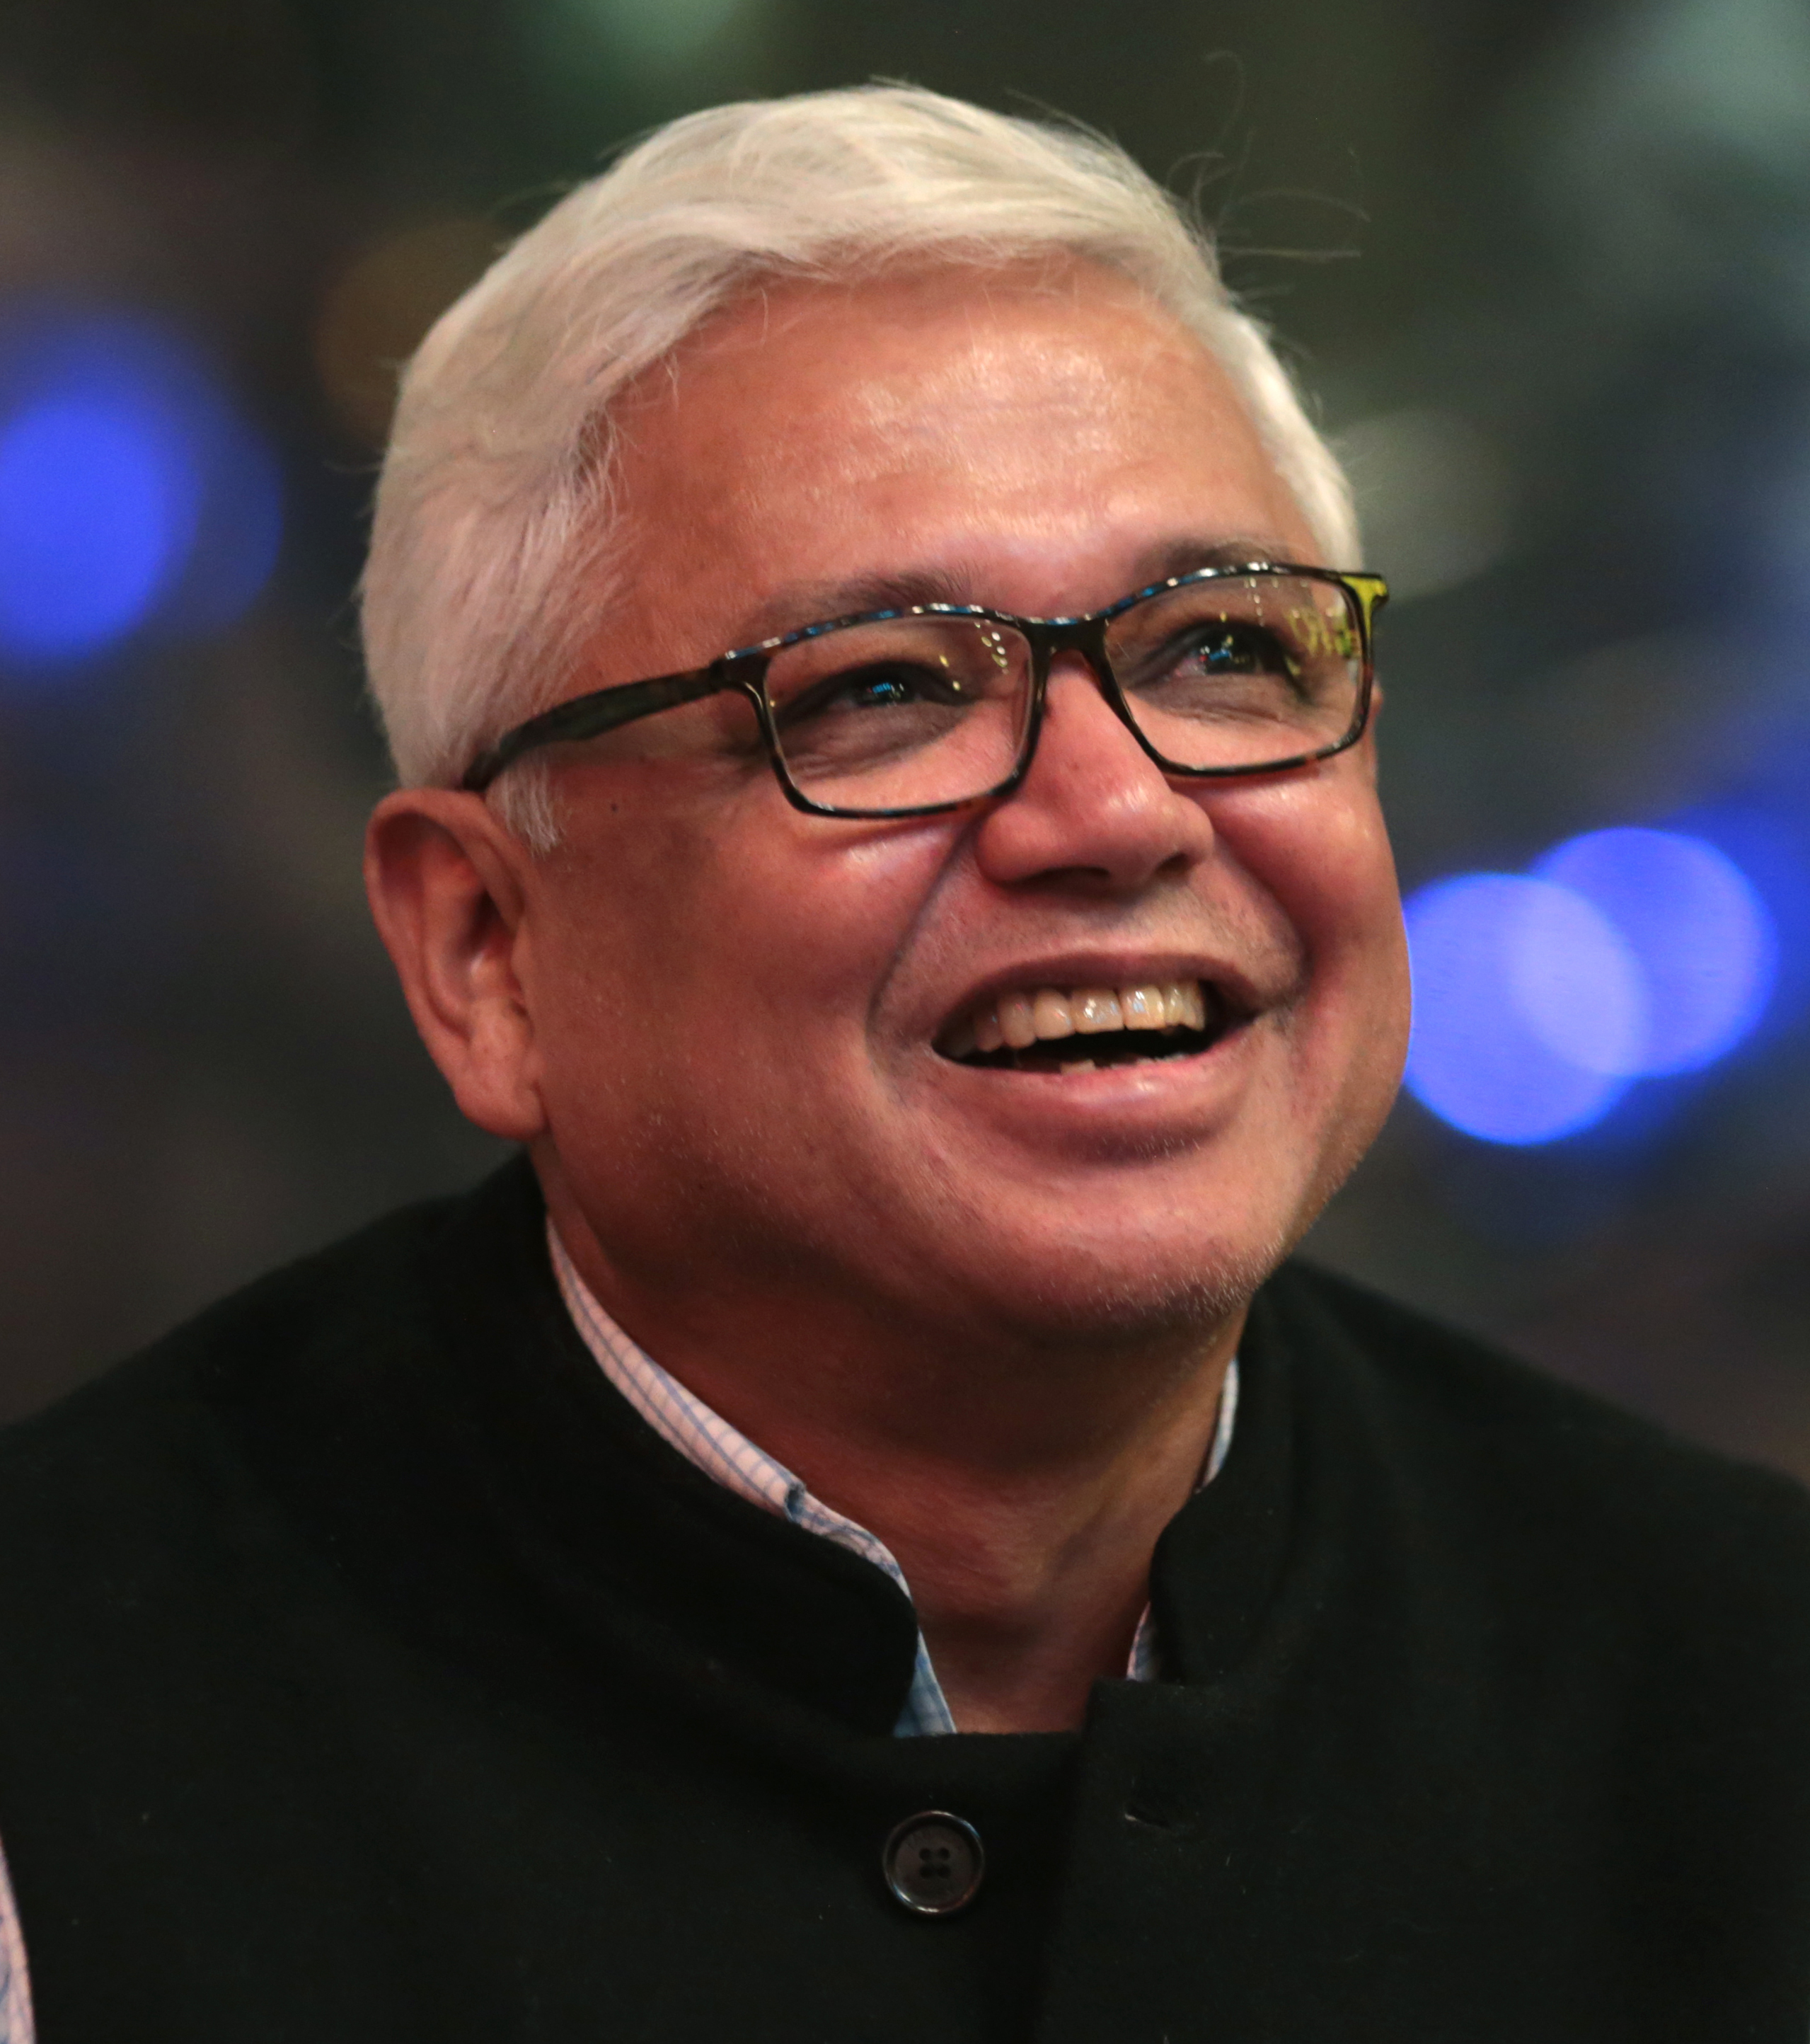
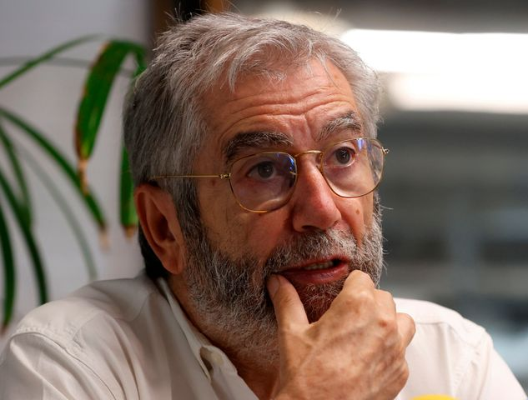
Abhijit Banerjee
Amit Chaudhuri
Amitav Ghosh
Antonio Muñoz Molina

Slide 12
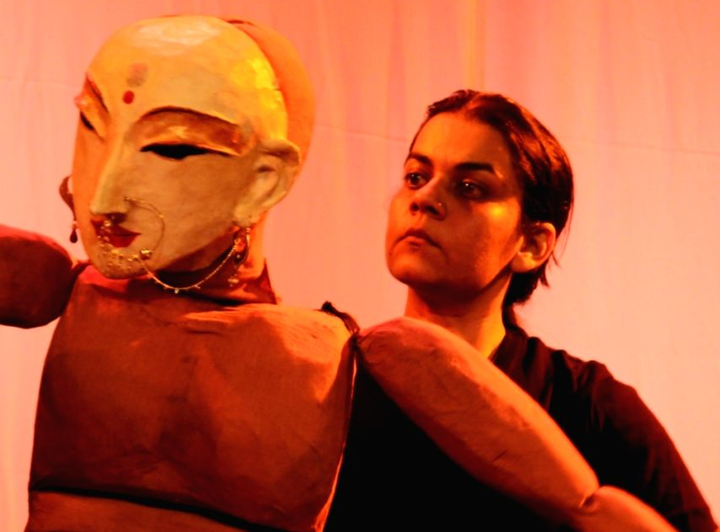
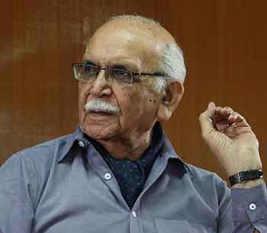
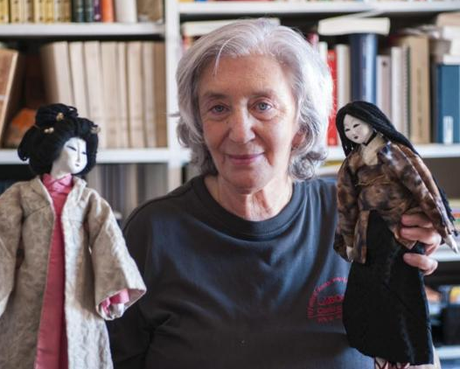
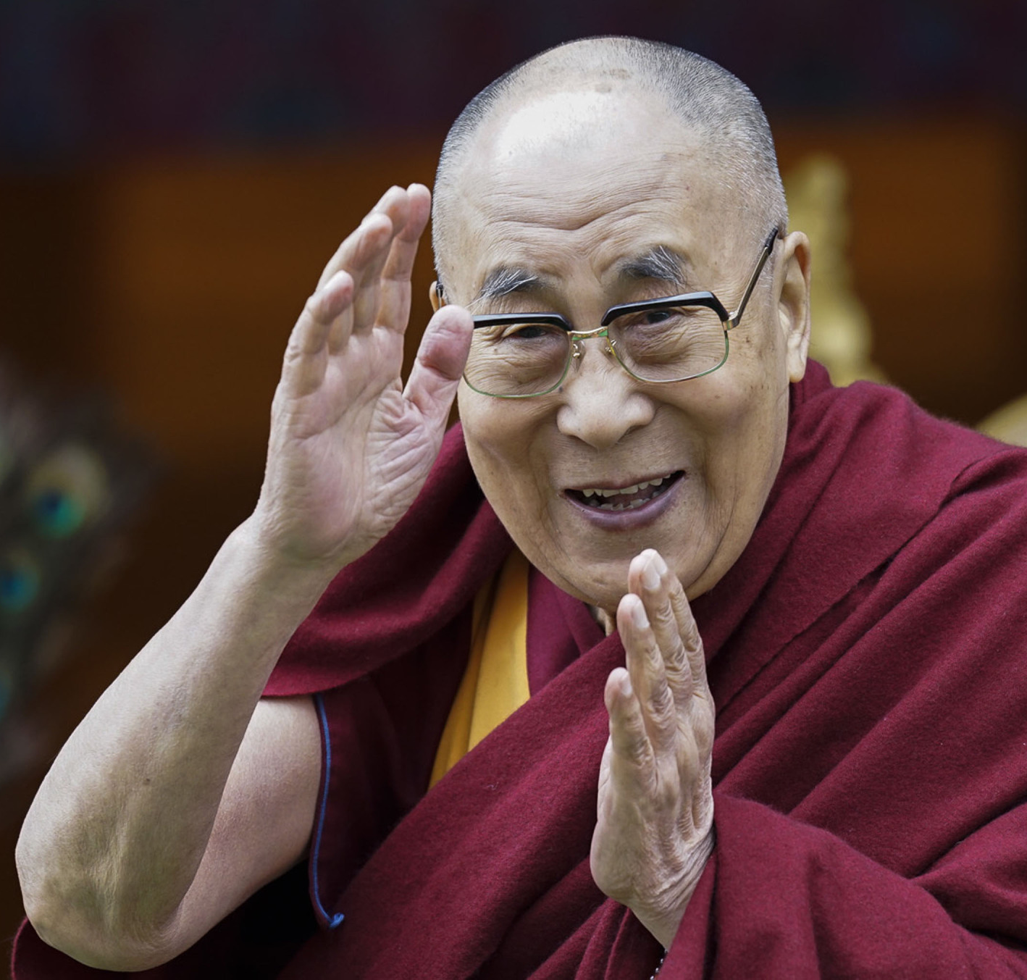
Anurupa Roy
BN Goswami
Clara Janés
Dalai Lama

Slide 13
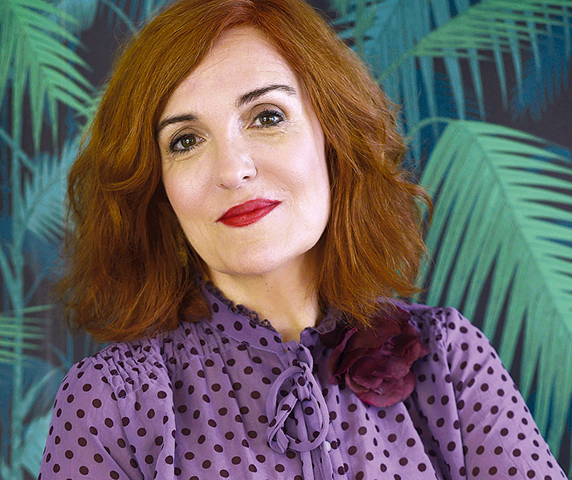
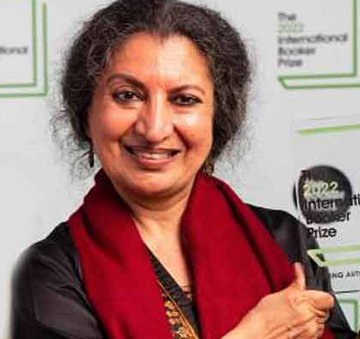
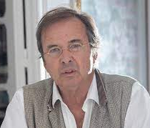
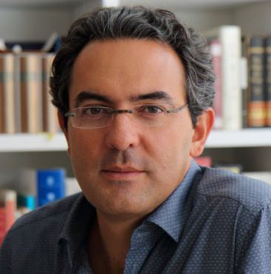
Elvira Lindo
Geetanjali Shree
Javier Moro
Juan Gabriel Vásquez

Slide 14
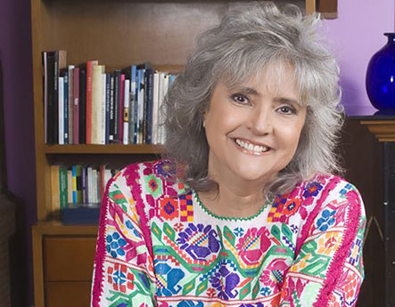
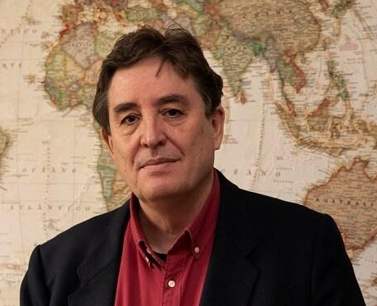
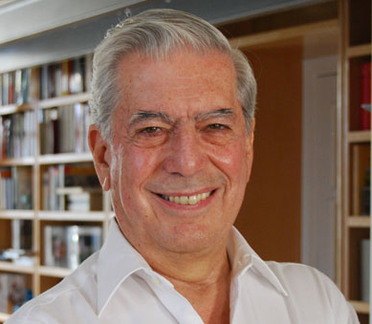
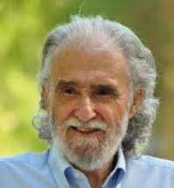
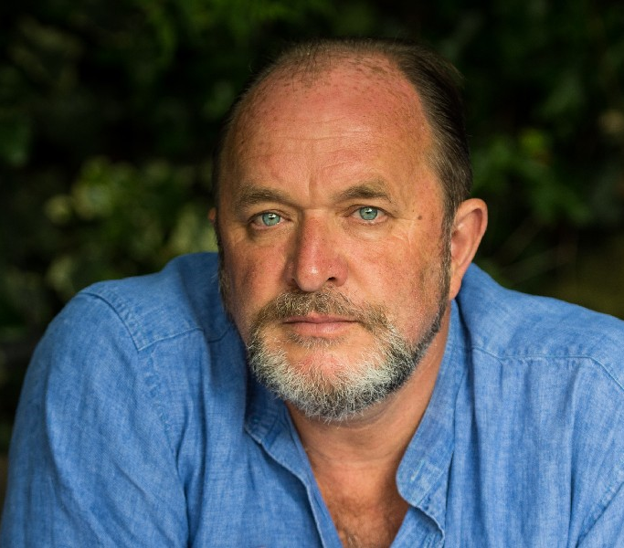
Laura Esquivel
Luis García Montero
Mario Vargas Llosa
Ramiro Calle
William Dalrymple

Slide 15
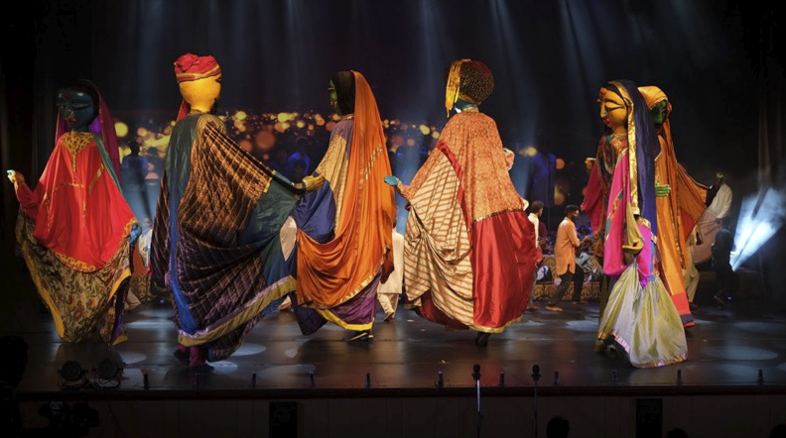
Festival Opening & Inaugural Keynote Address
A ceremonial procession with representatives from each community group in India and Spain, dressed in traditional attire, led by the giant puppets, colourful flags, and dance groups from both the countries.
Percussions from both countries will open the festival in a grand way.

Slide 16
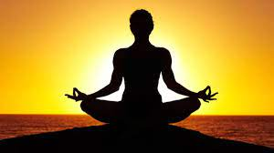
Yoga & Wellness
In the post-pandemic world, it is crucial to be mindful of your physical, mental and emotional well-being and what better way to do it then yoga!
Yoga is essentially a spiritual discipline focused on aligning the mind, body and soul in a harmonious union. Propagating the spiritual wealth of sages and seers, India is at the forefront when it come to spreading awareness about wellness and yoga traditions around the world.
With this belief, the Festival aims to integrate a wellness capsule that will focus on the many benefits of yoga while also sharing useful insights on how to create a lifestyle based on wellness and mindfulness via thoughtful morning sessions.

Slide 17
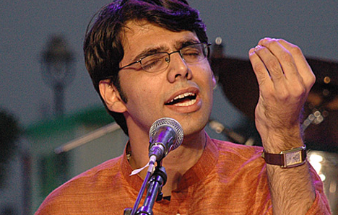
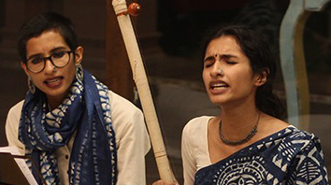
Soulful Morning Music
featuring
UJWAL NAGAR
AAHVAAN PROJECT

Slide 18
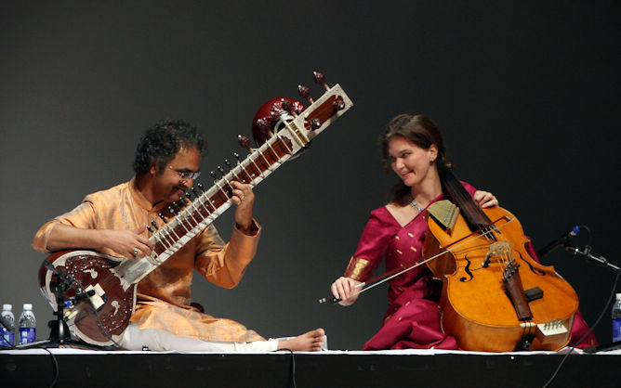
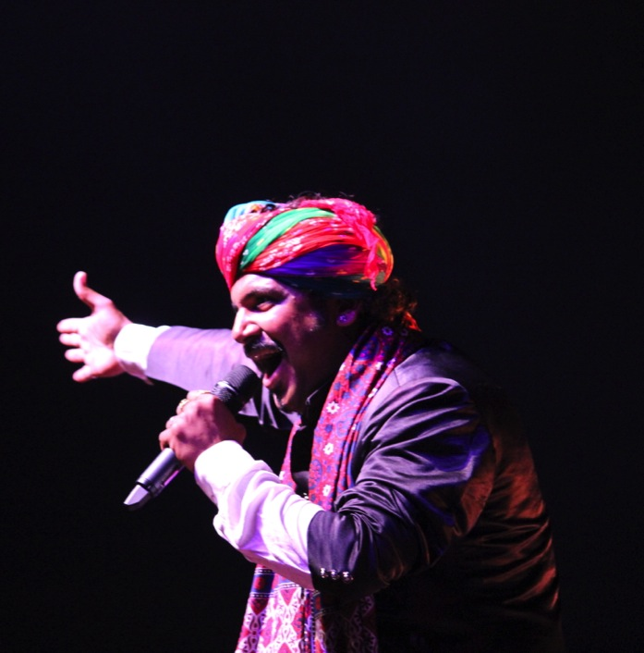
Evening Music Stage
featuring
SHUBHENDRA & SASKIA RAO
KUTLE KHAN PROJECT

Slide 19
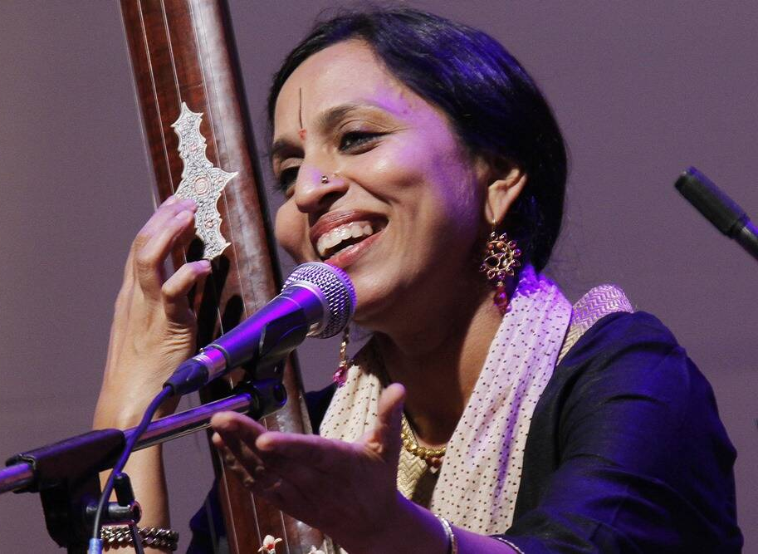
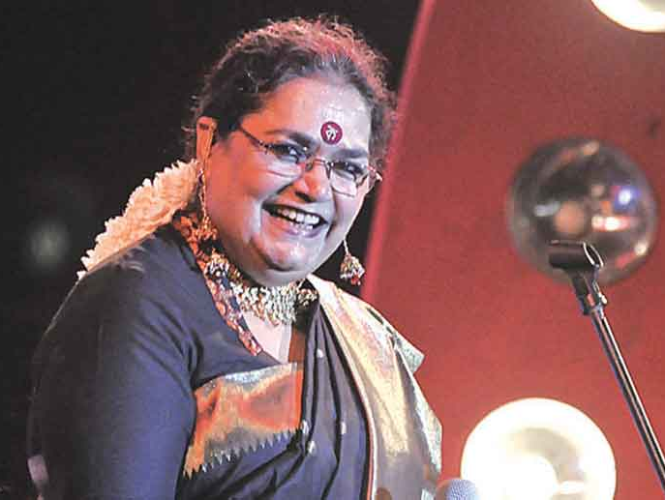
Music Stage
featuring
VIDYA SHAH
USHA UTHUP

Slide 20
Teamwork Arts is a highly versatile production company with roots in the performing arts, social action and the corporate world. For over 30 years, Teamwork Arts has taken India to the world and brought the world to India, presenting the finest of Indian performers, writers , change makers and visual artistes in the knowledge and arts space in India and abroad. Every year, we produce over 33 festivals in 42 cities and 17 countries in the fields of performing & visual arts and literature. We produce the world's largest literary gathering: the annual Jaipur Literature Festival; JLF international now travels to the US, UK, Canada, Australia and the Maldives and soon in Europe. Even amidst the upheaval and unsettling times of 2020 and through 2021, Teamwork Arts successfully launched the digital series, ‘JLF Brave New World’ and ‘Words Are Bridges’. Our musical extravaganza, Bollywood Love Story - A Musical continues to tour the world with sold-out shows everywhere it is held.

Slide 21
